Slide 1
Shor’s Algorithm

Slide 2
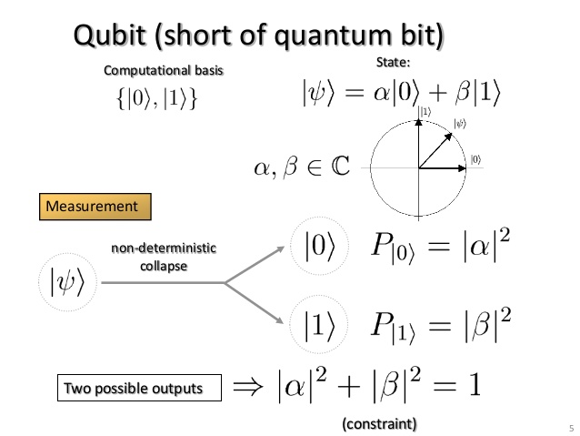
Important concepts

Slide 3
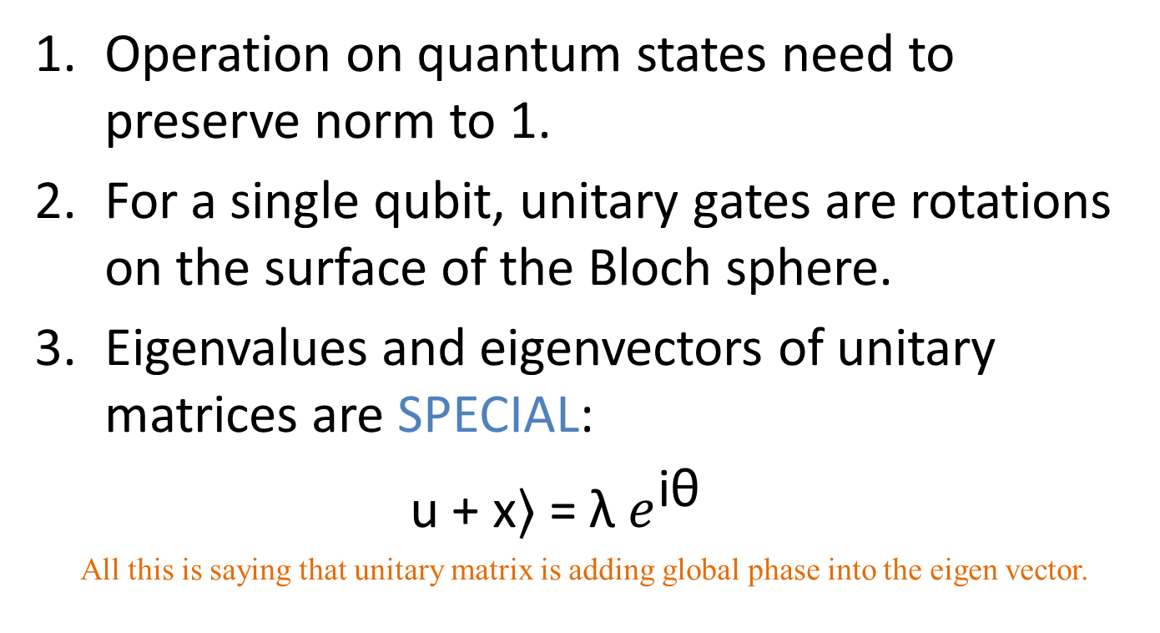
Implications
Operation on quantum states need to preserve norm to 1.
For a single qubit, unitary gates are rotations on the surface of the Bloch sphere.
Eigenvalues and eigenvectors of unitary matrices are SPECIAL:
u + x⟩ = λ $e^{\text{i}\text{θ}}$
All this is saying that unitary matrix is adding global phase into the eigen vector.

Slide 4
Basic Definition
Shor’s Algorithm uses the Quantum Fourier Transform and modular exponentiation to find the period of a signal.
It is important because it operates in polynomial time, exponentially faster than classical methods of doing this.

Slide 5
Why are we learning Shor’s Algorithm?
The problem of factoring a number which is a product of two prime numbers is the basis for the security of our computers. However, it is not easy to access because it requires several Q-bits that are good ones.
The idea of periodicity and the idea of factoring numbers are very much related and the simplicity to convert from one to another is why Shor’s Algorithm is successful.

Slide 6
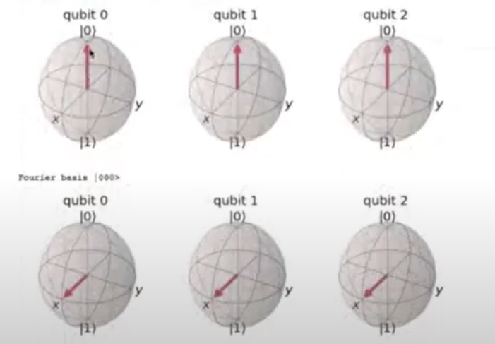
Quantum Fourier Transform
A quantum Fourier transform is effectively a change of basis from computational basis to Fourier basis.
For one qubit,
Computational (Z) basis States: {|0⟩, |1⟩}
Fourier basis (X) states: {|+⟩,|-⟩}

Slide 7


Quantum Fourier Transform cont.
It should be noted that this is the function of an H-gate in quantum computing.
The formula for the QFT is as following with N = 2^n:

Slide 8
Quantum Fourier Transform cont.
Implementation shows that the QFT of, for example, 0000, results in 4 qubits pointing in the |+⟩ state on the Bloch sphere. Counting up from this causes each qubit state to rotate around the x-y plane of the Bloch sphere.

Slide 9

Quantum Fourier Transform cont.
Expanding and rewriting this sum results in the following generic equation:
Where the “circle x” denotes individual qubits.

Slide 10



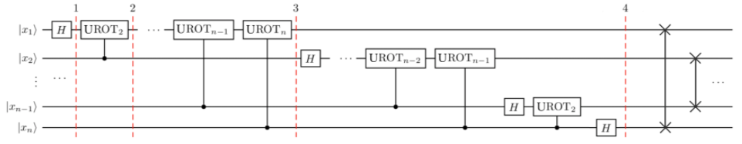
QFT Implementation
Quantum implementation of a QFT is done by using Hadamard gates and a number of controlled-UROT gates. The notation of the controlled-UROT gates is the first bit, here shown and 0 or 1 are the control bits.
The functions of these gates as well as the quantum implementation of an n-qubit QFT is shown below. Note that the qubit states are switched at the end as the rotations are being done in the reverse order of qubits.

Slide 11
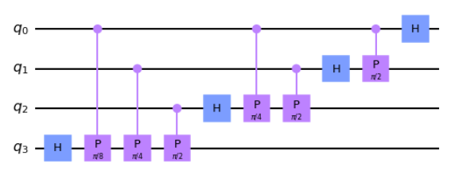
QFT Implementation cont.
The following qiskit code implements the rotation portion of the QFT:
def qft_rotations(circuit, n):
"""Performs qft on the first n qubits in circuit (without swaps)"""
if n == 0:
return circuit
n -= 1
circuit.h(n)
for qubit in range(n):
circuit.cp(pi/2**(n-qubit), qubit, n)
# At the end of our function, we call the same function again on
# the next qubits (we reduced n by one earlier in the function)
qft_rotations(circuit, n)
# Let's see how it looks:
qc = QuantumCircuit(4)
qft_rotations(qc,4)
qc.draw()
Circuit Visualization

Slide 12
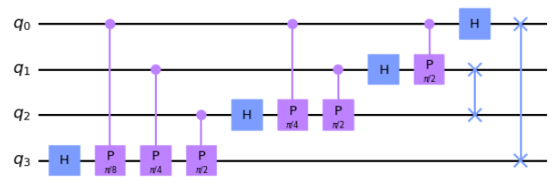
QFT Implementation cont.
The following qiskit code implements the previous rotation code and swaps the resulting output qubits.
def swap_registers(circuit, n):
for qubit in range(n//2):
circuit.swap(qubit, n-qubit-1)
return circuit
def qft(circuit, n):
"""QFT on the first n qubits in circuit"""
qft_rotations(circuit, n)
swap_registers(circuit, n)
return circuit
# Let's see how it looks:
qc = QuantumCircuit(4)
qft(qc,4)
qc.draw()
Circuit Visualization

Slide 13
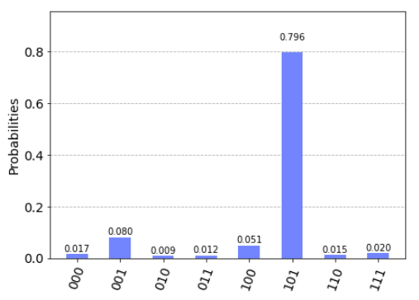
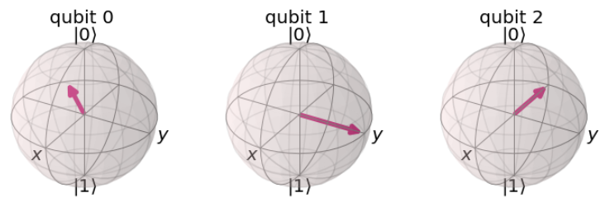
Inverse QFT
The Inverse Quantum Fourier Transform can be accomplished using the reverse of these steps. Qiskit has a built in function qft_circ_inverse() that accomplishes this.
Given the qubit state of |5˜⟩, which is the transformed value for decimal 5 shown below, the histogram shows the results of an inverse QFT which shows the value is most likely 5.

Slide 14
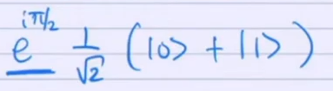
Quantum Phase Estimation
With normal probability measurement of a Qubit with a phase angle such as
The angle disappears when taking the magnitude of the phase.
Quantum phase estimation is a method in which the value of the angle is “encoded” in the phase using H-gates and a controlled unitary operators.
The angle is important because it can be used to determine the computational-basis value from a superposition Fourier state.

Slide 15
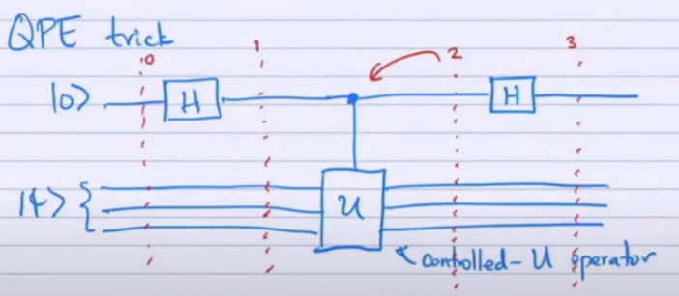

Quantum Phase Estimation cont.
The quantum circuit used to do this and the resulting equation is shown below.
Now, depending on the angle theta, the probability of measuring 0 or 1 changes, effectively estimating the angle of the original phase.
Multiple qubits can be used to measure the angle for better precision.

Slide 16
Quantum Phase Estimation cont.
The result of the unitary operators is something that very closely resembles a QFT.
Because of this, an inverse QFT can be taken of the result of the QPE is 2^{n}*θ where n is the amount of measuring qubits.
Dividing the result by 2^{n} then gives the angle θ.
Finding theta in this way plays an important role in Shor’s Algorithm.

Slide 17


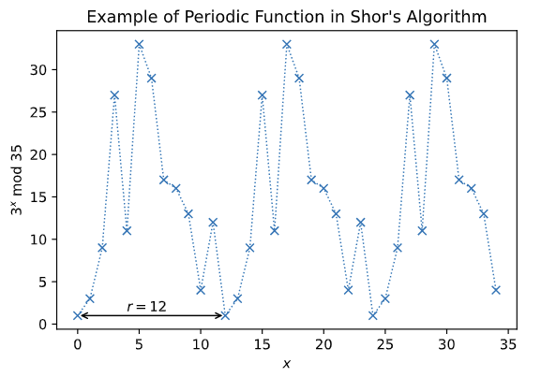
Period Finding
Given the periodic function:
Where a and N are positive, a < N, and they share no common factors.
The period for this application, r, is when:
Visualization of Periodicity

Slide 18
Qiskit Lecture Videos
Part 1:
https://www.youtube.com/watch?v=mAHC1dWKNYE&t=938s
Part 2:
https://www.youtube.com/watch?v=pq2jkfJlLmY
Part 3:
https://www.youtube.com/watch?v=5kcoaanYyZw

Slide 19
Qiskit Lecture Videos cont.
Part 4:
https://www.youtube.com/watch?v=YpcT8u2a2jc
Part 5:
https://www.youtube.com/watch?v=dscRoTBPeso&t=1031s
Shor's Algorithm (qiskit.org)

